Slide 1


Ensemble Learning
14
PART III · SUPERVISED LEARNING ALGORITHMS
CHAPTER 14 · WEEK 12
Machine Learning — From Hypotheses to Decisions
LECTURER
Dr. Mustafa Hameed
THE ISLAMIA UNIVERSITY OF BAHAWALPUR
Bahawalpur, Pakistan
Department of Information Technology · BSIT · Fall 2026
Notes:
Chapter 14: Ensemble Learning. Part 3 — Supervised Learning Algorithms. Week 12: Ensemble learning. Handout pages 103–111.

Slide 2

Where this chapter sits
THE COURSE
PART I
PART II
PART III
PART IV
PART V
PART VI
1
2
3
4
5
6
7
8
9
10
11
12
13
14
15
16
17
18
19
20
21
22
Ensemble Learning
BUILDS ON
USED LATER IN
Ch 7 Overfitting, Bias–Variance and Regularisation
Ch 22 The Machine Learning Project
Ch 9 Decision Tree Learning
Ch 10 Bayesian Learning and Naive Bayes
Machine Learning · Chapter 14 · Ensemble Learning
Handout p. 103 2
Notes:
Place the chapter. Before you start: Chapter 9 (decision trees and their instability), Chapter 7 (bias and variance) and Chapter 10 (the Bayes optimal classifier as a weighted vote of hypotheses).

Slide 3

What you will be able to do
LEARNING OUTCOMES
By the end of this chapter you will be able to:
1
Explain why a committee of hypotheses can be more accurate than its members, and compute the accuracy of a majority vote.
2
Describe bagging and random forests, and explain which part of the error they reduce.
3
Perform one round of AdaBoost by hand: weighted error, learner weight and example reweighting.
4
Describe gradient boosting and stacking.
5
Choose between bagging and boosting for a given problem.
Machine Learning · Chapter 14 · Ensemble Learning
Handout p. 103 3
Notes:
Read these out: they are the chapter's contract with the room. Each click adds one.

Slide 4

Vocabulary for this chapter
KEY TERMS
ensemble
committee
majority (hard) vote
soft vote
independent errors
bootstrap sample
bagging
out-of-bag estimate
random forest
feature importance
boosting
weak learner
AdaBoost
decision stump
gradient boosting
stacking
Each term is defined where it first matters — not here.
Machine Learning · Chapter 14 · Ensemble Learning
Handout p. 103 4
Notes:
Do not define these now; they arrive one at a time. This slide is for the students' notes. Terms: ensemble; committee; majority (hard) vote; soft vote; independent errors; bootstrap sample; bagging; out-of-bag estimate; random forest; feature importance; boosting; weak learner; AdaBoost; decision stump; gradient boosting; stacking.

Slide 5

In this chapter
IN THIS CHAPTER
14.1
Committees of Hypotheses
p. 103 ›
14.2
Bagging
p. 104 ›
14.3
Random Forests
p. 105 ›
14.4
Boosting
p. 105 ›
14.5
Stacking
p. 106 ›
Machine Learning · Chapter 14 · Ensemble Learning
Handout pp. 103–111 5
Notes:
The route through the chapter. Each row is a link: click it to jump to that section in the slide show.

Slide 6
Committees of Hypotheses
SECTION 1 OF 5
14.1
14.1 Committees of Hypotheses
14.2 Bagging
14.3 Random Forests
14.4 Boosting
14.5 Stacking
Machine Learning · Chapter 14
Handout §14.1 6
Notes:
Pause. Name the question this section answers.

Slide 7

Why a Committee Can Beat Its Members
CONCEPT
If each member of a committee is right more often than not, and their mistakes are independent, the majority is right more often than any member: for the majority to be wrong, most members must be wrong on the same example at once. Everything in this chapter is a way of producing members that are individually decent and whose errors are as uncorrelated as possible.
Machine Learning · Chapter 14 · Ensemble Learning
§14.1 · Handout p. 103 7
Notes:
The Bayes optimal classifier of Chapter 10 lets every hypothesis vote, and no single hypothesis can beat it. Ensemble methods are the practical version of that idea: train several models, and combine their predictions. They are, in practice, the most accurate off-the-shelf learners for tabular data — the random forests and gradient-boosted trees of this chapter win most such competitions.

Slide 8

The Arithmetic of a Majority Vote
WORKED EXAMPLE
Five late-task classifiers, each 70% accurate, with independent errors. The majority is right when at least three are right:
Twenty-one such classifiers give 0.974; a hundred and one classifiers that are each only 60% accurate give 0.979.
The catch is “independent”. Five copies of the same classifier make the same mistakes and vote as one: 70%. Real ensemble members are correlated, so the gains are smaller than this — and the whole craft is in reducing the correlation.
Machine Learning · Chapter 14 · Ensemble Learning
§14.1 · Handout p. 103 8
Notes:
Each click adds one step of the working. Ask for the next number before you reveal it.

Slide 9
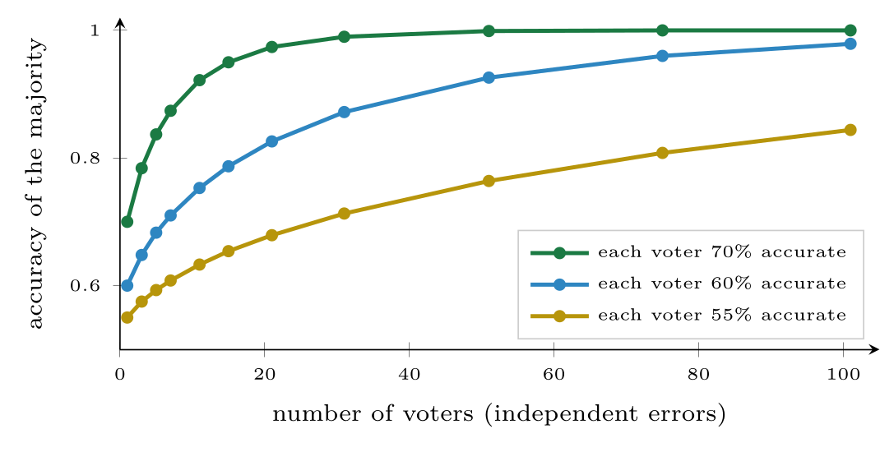
How majority voting amplifies weak but independent voters
FIGURE 14.1
Even 55%-accurate members reach 84% with a hundred voters — if, and only if, their mistakes are independent.
Machine Learning · Chapter 14 · Ensemble Learning
§14.1 · Handout p. 103 9
Notes:
Figure 14.1 (handout p. 104): How majority voting amplifies weak but independent voters. Even 55%-accurate members reach 84% with a hundred voters — if, and only if, their mistakes are independent.

Slide 10
Bagging
SECTION 2 OF 5
14.2
14.1 Committees of Hypotheses
14.2 Bagging
14.3 Random Forests
14.4 Boosting
14.5 Stacking
Machine Learning · Chapter 14
Handout §14.2 10
Notes:
Pause. Name the question this section answers.

Slide 11

Bagging (Bootstrap Aggregating)
DEFINITION
From a training set of n examples, draw B bootstrap samples, each of n examples drawn with replacement. Train one model on each sample. Predict by majority vote (classification) or by averaging (regression).
Machine Learning · Chapter 14 · Ensemble Learning
§14.2 · Handout p. 104 11
Notes:
Voting comes in two forms. A hard vote counts class predictions. A soft vote averages predicted probabilities and picks the largest, which lets a confident member outweigh several unsure ones and is usually a little better.

Slide 12
A Free Validation Set: the Out-of-Bag Estimate
CONCEPT
Each example is left out of about 37% of the bootstrap samples. Predict it using only the models that did not see it, and the resulting out-of-bag error is an honest estimate of test error — computed during training, with no data held back.
Machine Learning · Chapter 14 · Ensemble Learning
§14.2 · Handout p. 104 12
Notes:
Each bootstrap sample leaves some examples out and repeats others: the chance that a given example is never drawn in n draws is (1 − 1/n)n ≈ e−1 = 0.368, so each sample contains about 63.2% of the distinct examples. The models therefore differ, and their errors are partly decorrelated. Bagging helps exactly when the base learner is unstable: when small changes in the training data produce very different models. That describes a fully grown decision tree (Chapter 9) precisely — high variance, low bias — and bagging averages the variance away while keeping the low bias. It does little for a stable learner such as linear regression or k-NN with large k.

Slide 13
Random Forest
DEFINITION
Bag fully grown decision trees, with one change: at each split, choose the best test from a random subset of the features only — typically √d of the d features for classification. Different trees are forced to use different features, so their errors are less correlated and the average is better. A forest also reports each feature’s importance: the total reduction in impurity from splits on that feature, averaged over the trees.
Machine Learning · Chapter 14 · Ensemble Learning
§14.3 · Handout p. 105 13
Notes:
Bagged trees are still correlated: if one feature is very strong, every tree puts it at the root and the trees look alike. A random forest (Breiman, 2001) decorrelates them further.

Slide 14
Boosting
SECTION 4 OF 5
14.4
14.1 Committees of Hypotheses
14.2 Bagging
14.3 Random Forests
14.4 Boosting
14.5 Stacking
Machine Learning · Chapter 14
Handout §14.4 14
Notes:
Pause. Name the question this section answers.

Slide 15
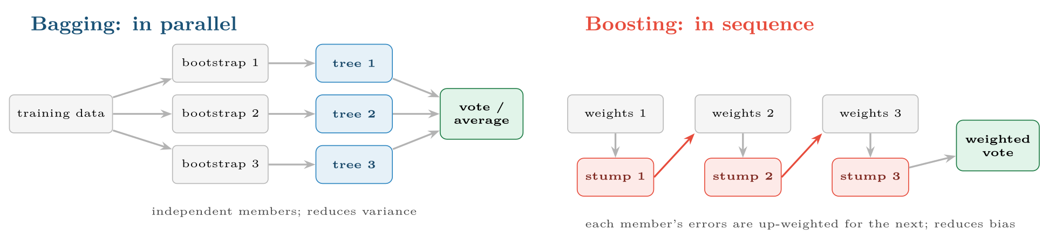
Bagging trains independent models on resampled data and averages them
FIGURE 14.2
Boosting trains models one after another, re-weighting the data towards the examples still being misclassified, and combines them with a weighted vote.
Machine Learning · Chapter 14 · Ensemble Learning
§14.4 · Handout p. 105 15
Notes:
Random forests are the safest default for tabular data: few hyperparameters (the number of trees, which only needs to be large enough, and the feature-subset size), no scaling, robust to irrelevant features, and hard to overfit by adding trees. Bagging trains its members independently and in parallel. Boosting trains them in sequence, each one concentrating on the examples its predecessors got wrong. Its members are weak learners — barely better than chance, typically decision stumps (one-split trees) or very shallow trees — and it is bias, not variance, that boosting mainly reduces.
Figure 14.2 (handout p. 105): Bagging trains independent models on resampled data and averages them. Boosting trains models one after another, re-weighting the data towards the examples still being misclassified, and combines them with a weighted vote.

Slide 16
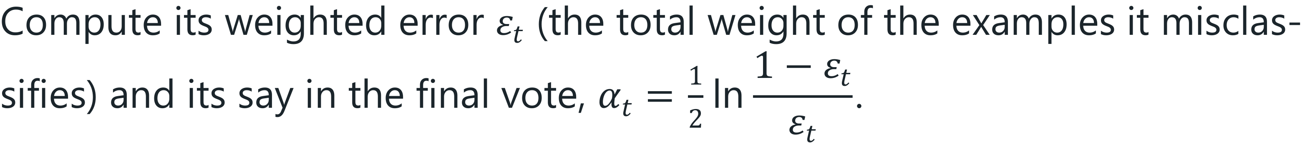
AdaBoost
DEFINITION
Give every training example the weight 1/n. For rounds t = 1, …, T:
1. Train a weak learner h_{t} on the weighted data.
2.
3. Multiply the weight of each misclassified example by e^{α}_{t} and of each correct one by e^{−α}_{t}; renormalise to sum to 1.
Machine Learning · Chapter 14 · Ensemble Learning
§14.4 · Handout p. 105 16
Notes:
Read the box aloud, then ask for an example from the room before moving on.

Slide 17
One Round of AdaBoost
WORKED EXAMPLE
Ten examples, each of weight 0.1. The first stump misclassifies three of them.
Weighted error: ε₁ = 3 × 0.1 = 0.3.
Reweight: e^{0.424} = 1.528 and e^{−0.424} = 0.655.
• three mistakes: 0.1 × 1.528 = 0.1528 each (total 0.458);
• seven correct: 0.1 × 0.655 = 0.0655 each (total 0.458).
Normalise by the total 0.917: mistakes → 0.167 each, correct → 0.071 each.
After the update the three mistakes carry exactly half the total weight — always true in AdaBoost. The next stump, trained on these weights, cannot score better than chance by repeating the first stump’s errors, so it is forced to attend to them. A stump with ε = 0.5 would get α = 0: no say at all.
Machine Learning · Chapter 14 · Ensemble Learning
§14.4 · Handout p. 105 17
Notes:
Each click adds one step of the working. Ask for the next number before you reveal it.

Slide 18
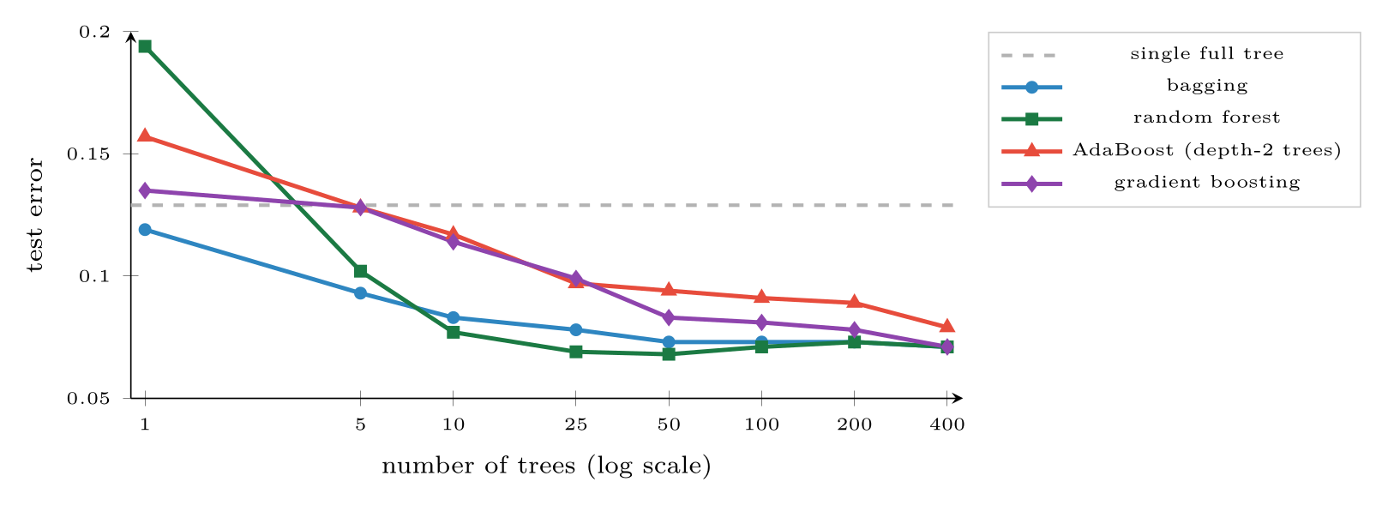
Test error against ensemble size on a 3,000-example problem with 5% label noise
FIGURE 14.3
Every ensemble roughly halves the error of a single tree. Averaging methods level off quickly; boosting keeps improving for longer.
Machine Learning · Chapter 14 · Ensemble Learning
§14.4 · Handout p. 105 18
Notes:
Gradient boosting generalises the idea to any differentiable loss. Start with a constant prediction; at each round, fit a small tree to the current residuals (more generally, to the negative gradient of the loss), and add a fraction η — the learning rate, typically 0.05–0.1 — of its predictions to the model. Each tree corrects what the ensemble so far gets wrong. Libraries such as XGBoost and LightGBM are highly engineered versions, and are the first thing most practitioners try on a tabular problem.
Figure 14.3 (handout p. 106): Test error against ensemble size on a 3,000-example problem with 5% label noise. Every ensemble roughly halves the error of a single tree. Averaging methods level off quickly; boosting keeps improving for longer.

Slide 19

Stacking
AT A GLANCE
Method | Members | Mainly reduces | Watch out for
Bagging | Deep trees on bootstrap samples, in parallel | Variance | Little gain with stable learners
Random forest | Bagged trees with random feature subsets | Variance | Importances biased towards many-valued features
AdaBoost | Stumps or shallow trees, in sequence | Bias (and variance) | Label noise: mislabelled points get ever larger weights
Gradient boosting | Shallow trees fitted to residuals | Bias (and variance) | Overfits with too many trees at a high learning rate; tune both
Stacking | Different model types plus a combiner | Whatever the base models miss | Leakage if the combiner is trained on in-sample predictions
Machine Learning · Chapter 14 · Ensemble Learning
§14.5 · Handout p. 106 19
Notes:
Stacking combines different kinds of model. Train several base models — say logistic regression, an SVM (Chapter 12) and a random forest — then train a second-level model (often logistic regression) whose inputs are the base models’ predictions and whose target is the true label. To avoid leakage, the second-level training data must be the base models’ predictions on examples they did not train on, produced by cross-validation. Stacking learns how much to trust each base model, and when.

Slide 20

Common pitfalls
COMMON PITFALLS
✕
Ensembling copies of the same model. Correlated members vote as one; diversity is the whole point.
✕
Boosting noisy labels without limit. AdaBoost’s weights chase mislabelled points; use fewer rounds, a lower learning rate, or bagging.
✕
Reading impurity importances as causal. They say what the forest used, not what drives the outcome, and they favour many-valued features.
✕
Training a stacking combiner on in-sample predictions. Use cross-validated predictions.
✕
Forgetting the cost. Hundreds of trees are slower to run and harder to explain than one; check that the gain is worth it.
Machine Learning · Chapter 14 · Ensemble Learning
§14.5 · Handout p. 106 20
Notes:
For each pitfall, ask who has seen it happen. One real story beats five bullets.

Slide 21

Try it yourself: One Tree Against Five Ensembles
TRY IT YOURSELF
Part 2 uses 3,000 synthetic past tasks, each described by twenty numeric features, of which 5% were recorded with the wrong outcome.
WHAT YOU WILL DO
1. One round of AdaBoost, by hand
2. One tree against five ensembles
3. A free validation estimate, and what the forest looked at
THIS WEEK'S LAB
WHAT YOU WILL RUN
RUNNABLE COPY
Week 12: One tree against five ensembles
1 listing, 51 lines of Python
code/ch14_one_tree_against_five.py
Machine Learning · Chapter 14 · Ensemble Learning
§14.5 · Handout p. 106 21
Notes:
Part 2 uses 3,000 synthetic past tasks, each described by twenty numeric features, of which 5% were recorded with the wrong outcome.

Slide 22
One Tree Against Five Ensembles
LAB · STEP 1 OF 5
Set-up
Python · code/ch14_one_tree_against_five.py
2
3
4
5
6
7
8
9
import numpy as np
from sklearn.datasets import make_classification
from sklearn.model_selection import cross_val_score
from sklearn.tree import DecisionTreeClassifier
from sklearn.linear_model import LogisticRegression
from sklearn.ensemble import (BaggingClassifier, RandomForestClassifier,
AdaBoostClassifier, GradientBoostingClassifier,
VotingClassifier)
Machine Learning · Chapter 14 · Ensemble Learning
§14.5 · Handout p. 106 22
Notes:
Step 1: Set-up. Read the code aloud; ask what each line would print before running it.

Slide 23
One Tree Against Five Ensembles
LAB · STEP 2 OF 5
One round of AdaBoost, by hand
Python · code/ch14_one_tree_against_five.py
11
12
13
14
15
16
17
18
19
# --- 1. one round of AdaBoost, by hand -----------------------------------
w = np.full(10, 0.1) # ten examples, equal weight
wrong = np.array([1, 1, 1, 0, 0, 0, 0, 0, 0, 0], dtype=bool)
eps = w[wrong].sum() # weighted error = 0.3
alpha = 0.5 * np.log((1 - eps) / eps) # say of this learner
w = np.where(wrong, w * np.exp(alpha), w * np.exp(-alpha))
w = w / w.sum()
print(f"alpha = {alpha:.3f}; new weights: wrong {w[0]:.4f}, "
f"right {w[-1]:.4f}; weight on the mistakes = {w[wrong].sum():.2f}")
Machine Learning · Chapter 14 · Ensemble Learning
§14.5 · Handout p. 106 23
Notes:
Step 2: One round of AdaBoost, by hand. Read the code aloud; ask what each line would print before running it.

Slide 24
One Tree Against Five Ensembles
LAB · STEP 3 OF 5
One tree against five ensembles
Python · code/ch14_one_tree_against_five.py
21
22
23
24
# --- 2. one tree against five ensembles ----------------------------------
X, y = make_classification(n_samples=3000, n_features=20, n_informative=8,
n_redundant=4, flip_y=0.05, random_state=7)
tree = DecisionTreeClassifier
Machine Learning · Chapter 14 · Ensemble Learning
§14.5 · Handout p. 106 24
Notes:
Step 3: One tree against five ensembles. Read the code aloud; ask what each line would print before running it.

Slide 25
One Tree Against Five Ensembles
LAB · STEP 4 OF 5
One tree against five ensembles (continued)
Python · code/ch14_one_tree_against_five.py
25
26
27
28
29
30
31
32
33
34
35
36
37
38
39
40
41
42
43
44
models = {
"single tree": tree(random_state=0),
"bagging (100 trees)": BaggingClassifier(tree(), n_estimators=100,
random_state=0),
"random forest (100)": RandomForestClassifier(n_estimators=100,
random_state=0),
"AdaBoost (depth 2)": AdaBoostClassifier(tree(max_depth=2),
n_estimators=200,
random_state=0),
"gradient boosting": GradientBoostingClassifier(n_estimators=200,
random_state=0),
"vote: LR + tree + RF": VotingClassifier([
("lr", LogisticRegression(max_iter=1000)),
("dt", tree(max_depth=6, random_state=0)),
("rf", RandomForestClassifier(n_estimators=100, random_state=0))],
voting="soft"),
}
for name, m in models.items():
s = cross_val_score(m, X, y, cv=5)
print(f"{name:24s} accuracy {s.mean():.3f} +/- {s.std():.3f}")
Machine Learning · Chapter 14 · Ensemble Learning
§14.5 · Handout p. 106 25
Notes:
Step 4: One tree against five ensembles (continued). Read the code aloud; ask what each line would print before running it.

Slide 26
One Tree Against Five Ensembles
LAB · STEP 5 OF 5
A free validation estimate, and what the forest looked at
Python · code/ch14_one_tree_against_five.py
46
47
48
49
50
51
52
# --- 3. a free validation estimate, and what the forest looked at --------
rf = RandomForestClassifier(n_estimators=300, oob_score=True,
random_state=0).fit(X, y)
print("random forest out-of-bag accuracy:", round(rf.oob_score_, 3))
top = np.argsort(-rf.feature_importances_)[:5]
print("most used features:", top.tolist(),
rf.feature_importances_[top].round(3).tolist())
Machine Learning · Chapter 14 · Ensemble Learning
§14.5 · Handout p. 106 26
Notes:
Step 5: A free validation estimate, and what the forest looked at. Read the code aloud; ask what each line would print before running it.

Slide 27
What the lab shows
TRY IT YOURSELF
Every ensemble beats the single tree by four to six points. Now set flip_y=0.3 (30% label noise) and compare bagging with AdaBoost again: which suffers more, and why?
Machine Learning · Chapter 14 · Ensemble Learning
§14.5 · Handout p. 106 27
Notes:
Read the box aloud, then ask for an example from the room before moving on.

Slide 28

Three independent classifiers are each 80% accurate. What is the accuracy of their majority vote?
CHECKPOINT 1 OF 3
Discuss with the person next to you, then advance.
Machine Learning · Chapter 14 · Ensemble Learning
Handout p. 111 · answers in Appendix D 28
Notes:
Ask the room. Do not advance until someone commits to an answer.

Slide 29

Three independent classifiers are each 80% accurate. What is the accuracy of their majority vote?
CHECKPOINT 1 OF 3 · ANSWER
3(0.8²)(0.2) + 0.8³ = 0.384 + 0.512 = 0.896.
Machine Learning · Chapter 14 · Ensemble Learning
Handout p. 111 · answers in Appendix D 29
Notes:
Answer (Appendix D): 3(0.82)(0.2) + 0.83 = 0.384 + 0.512 = 0.896.

Slide 30
A stump has weighted error 0.2. Compute its α and the factors by which misclassified and correct examples are re-weighted.
CHECKPOINT 2 OF 3
Discuss with the person next to you, then advance.
Machine Learning · Chapter 14 · Ensemble Learning
Handout p. 111 · answers in Appendix D 30
Notes:
Ask the room. Do not advance until someone commits to an answer.

Slide 31
A stump has weighted error 0.2. Compute its α and the factors by which misclassified and correct examples are re-weighted.
CHECKPOINT 2 OF 3 · ANSWER
α = 1/2ln(0.8/0.2) = 1/2ln 4 = 0.693. Misclassified examples are multiplied by e^{0.693} = 2, correct ones by e^{−0.693} = 0.5, before renormalising.
Machine Learning · Chapter 14 · Ensemble Learning
Handout p. 111 · answers in Appendix D 31
Notes:
Answer (Appendix D): α = 1/2ln(0.8/0.2) = 1/2ln 4 = 0.693. Misclassified examples are multiplied by e0.693 = 2, correct ones by e−0.693 = 0.5, before renormalising.

Slide 32
Why does bagging help a decision tree much more than it helps logistic regression?
CHECKPOINT 3 OF 3
Discuss with the person next to you, then advance.
Machine Learning · Chapter 14 · Ensemble Learning
Handout p. 111 · answers in Appendix D 32
Notes:
Ask the room. Do not advance until someone commits to an answer.

Slide 33
Why does bagging help a decision tree much more than it helps logistic regression?
CHECKPOINT 3 OF 3 · ANSWER
A tree is unstable: different bootstrap samples give very different trees, whose errors partly cancel when averaged. Logistic regression is stable: models on different bootstrap samples are nearly identical, so averaging them changes little.
Machine Learning · Chapter 14 · Ensemble Learning
Handout p. 111 · answers in Appendix D 33
Notes:
Answer (Appendix D): A tree is unstable: different bootstrap samples give very different trees, whose errors partly cancel when averaged. Logistic regression is stable: models on different bootstrap samples are nearly identical, so averaging them changes little.

Slide 34

What to take away
CHAPTER SUMMARY
1
A majority of individually decent, independent voters beats every voter; the work of ensemble learning is making members diverse.
2
Bagging trains unstable learners on bootstrap samples and averages them, reducing variance; out-of-bag examples give a free error estimate.
3
Random forests add random feature subsets at each split to decorrelate the trees; they are the safest default for tabular data.
4
Boosting trains weak learners in sequence on re-weighted data; AdaBoost gives each learner a say α = 1/2ln(1−ε)/ε and moves half the weight onto its mistakes. It reduces bias but is sensitive to label noise.
5
Gradient boosting fits each new tree to the current residuals; stacking learns how to combine different model types.
Machine Learning · Chapter 14 · Ensemble Learning
Handout p. 111 34
Notes:
Ask the room to say each takeaway before you reveal it.

Slide 35

Quick check 1 of 3
REVIEW · MULTIPLE CHOICE
A bootstrap sample of n examples contains about what fraction of the distinct examples?
A
50%
B
63%
C
90%
D
100%
Machine Learning · Chapter 14 · Ensemble Learning
Handout p. 111 35
Notes:
Take a show of hands for each option before discussing. (The handout does not print MCQ answers.)

Slide 36
Quick check 2 of 3
REVIEW · MULTIPLE CHOICE
Random forests differ from bagged trees by:
A
using stumps
B
re-weighting examples
considering a random subset of features at each split
C
D
pruning every tree
Machine Learning · Chapter 14 · Ensemble Learning
Handout p. 111 36
Notes:
Take a show of hands for each option before discussing. (The handout does not print MCQ answers.)

Slide 37
Quick check 3 of 3
REVIEW · MULTIPLE CHOICE
In AdaBoost, a weak learner with weighted error 0.5 receives a weight α of:
A
1
B
0.5
C
0
D
−1
Machine Learning · Chapter 14 · Ensemble Learning
Handout p. 111 37
Notes:
Take a show of hands for each option before discussing. (The handout does not print MCQ answers.)

Slide 38
For your notebook
REVIEW QUESTIONS
SHORT
Contrast bagging and boosting in terms of how members are trained and which error component each reduces.
SHORT
Explain the out-of-bag estimate and why it is honest.
SHORT
Why is AdaBoost sensitive to mislabelled training examples?
APPLIED
Compute the accuracy of a majority vote of seven independent classifiers that are each 65% accurate.
APPLIED
Continue the AdaBoost worked example: the second stump misclassifies two of the seven previously correct examples and none of the three previous mistakes. Compute ε₂, α₂ and the new weights.
Machine Learning · Chapter 14 · Ensemble Learning
Handout p. 111 38
Notes:
Set these for independent study. Model answers are not printed in the handout.

Slide 39
End of Chapter 14
14
NEXT
READ
Chapter 15 — Clustering
Handout Chapter 14, pages 103–111
THIS WEEK'S LAB
ASSESSMENT
One tree against five ensembles
Assignment 2 due
Machine Learning · Chapter 14 · Ensemble Learning
39
Notes:
Close. NEXT: Chapter 15 — Clustering. READ: Handout Chapter 14, pages 103–111. THIS WEEK'S LAB: One tree against five ensembles. ASSESSMENT: Assignment 2 due.

